Slide 1

G2M Insight For Cab Investment Firm
Data Analyst Virtual internship
Submitted by: Yihsuan Sun
Date: 05/19/2022

Slide 2
Outline
Problem Statement
Datasets Information
EDA
Hypothesis
Summary

Slide 3
Problem Statement

Slide 4
Problem Statement
XYZ is a private firm in US. Due to remarkable growth in the Cab Industry in last few years and multiple key players in the market, it is planning for an investment in Cab industry
Provide insights to help XYZ firm in identifying the right company for making an investment

Slide 5
Datasets Information

Slide 6
Datasets Information
Cab_Data.csv – this file includes details of transaction for 2 cab companies
Customer_ID.csv – this is a mapping table that contains a unique identifier which links the customer’s demographic details
Transaction_ID.csv – this is a mapping table that contains transaction to customer mapping and payment mode
City.csv – this file contains list of US cities, their population and number of cab users

Slide 7
Exploratory Data Analysis (EDA)

Slide 8
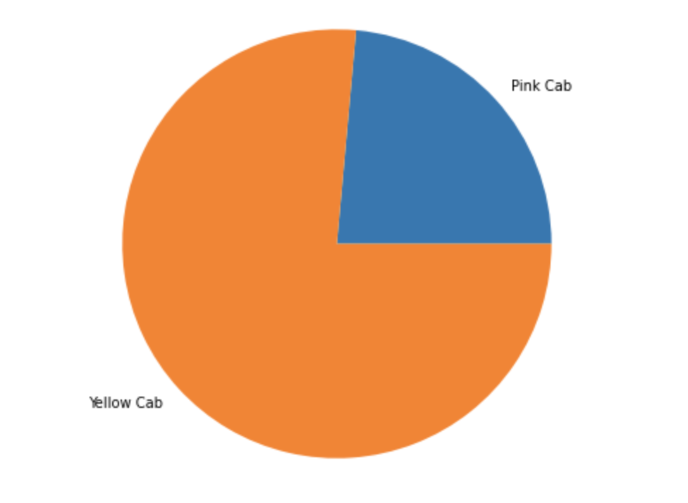
Which company has more transactions?
As we can see that Yellow Cab has more transaction numbers than Pink Cab

Slide 9
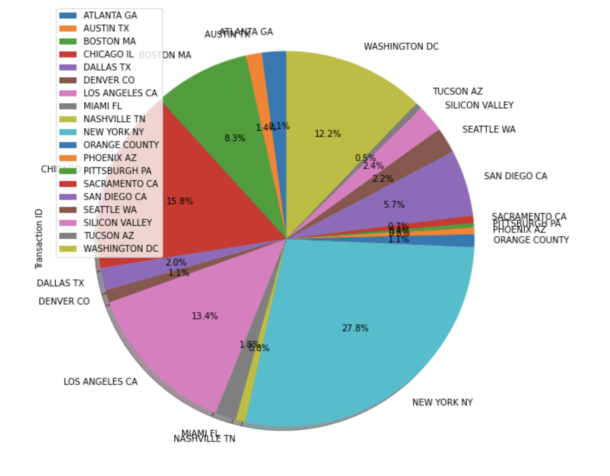
Number of transactions by city
The city with the highest number of transactions is New York, followed by Chicago

Slide 10
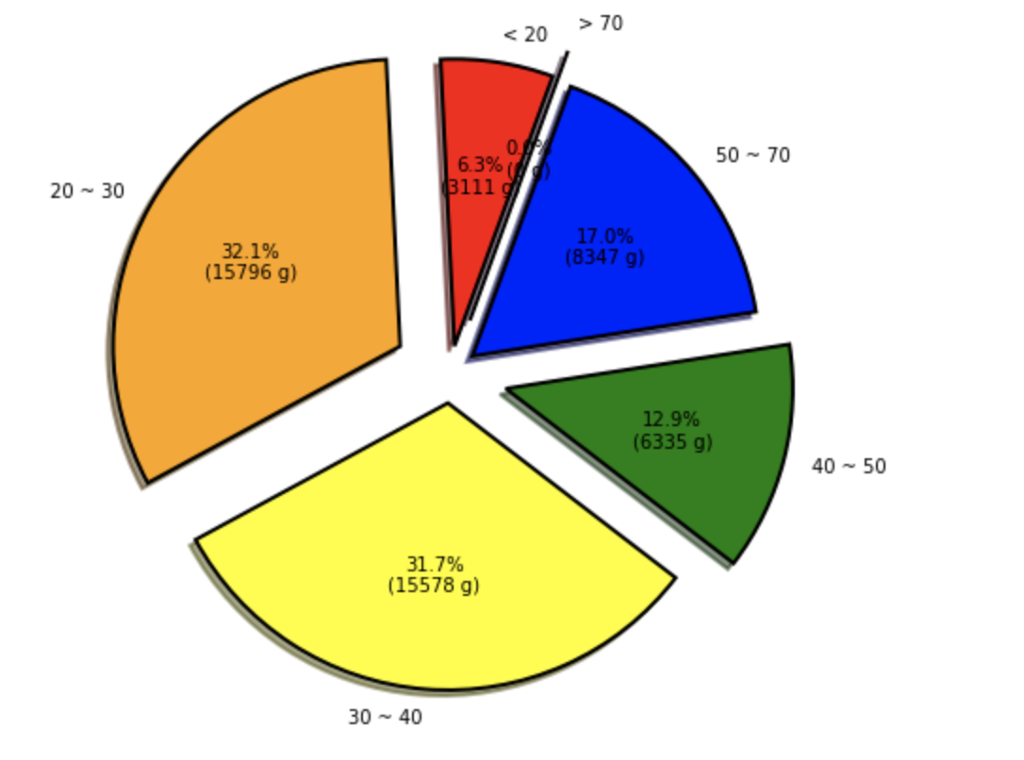
Age distribution of customers
We can see that 20 to 30 years old is the largest user group, followed by 30 to 40 years old

Slide 11
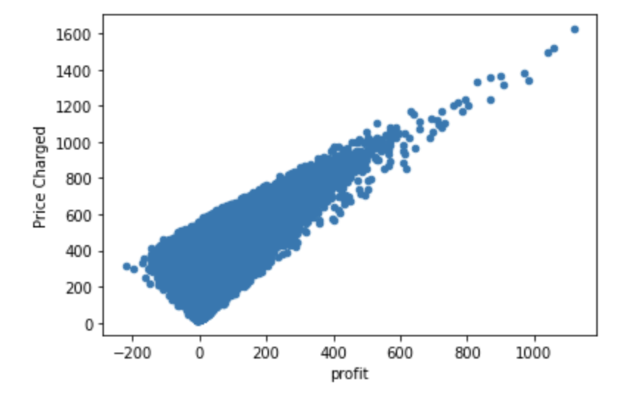
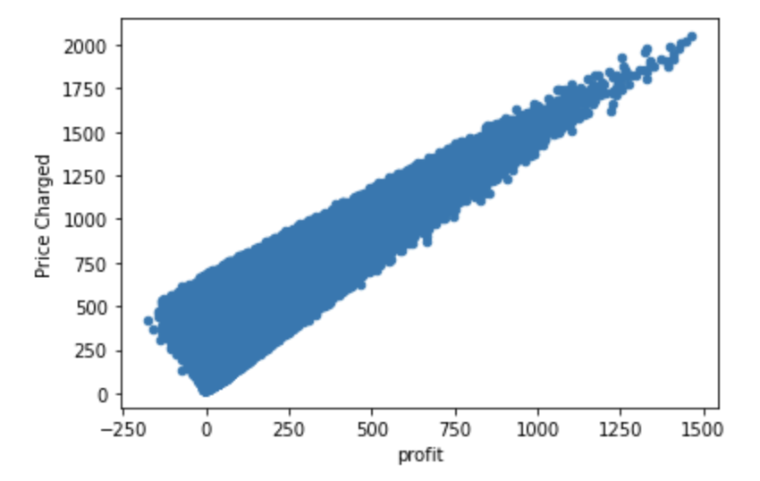
Negative profit
Pink cab
Yellow cab

Slide 12
Negative profit
As we can see from the last slide, both companies are showing negative profits in some of the transactions
We can see from the graph that the yellow cab has more negative profit trades than the pink cab
Gaining insight into negative profits, we can use graphs to see which situations lead to negative profits on trades (Next slide)

Slide 13
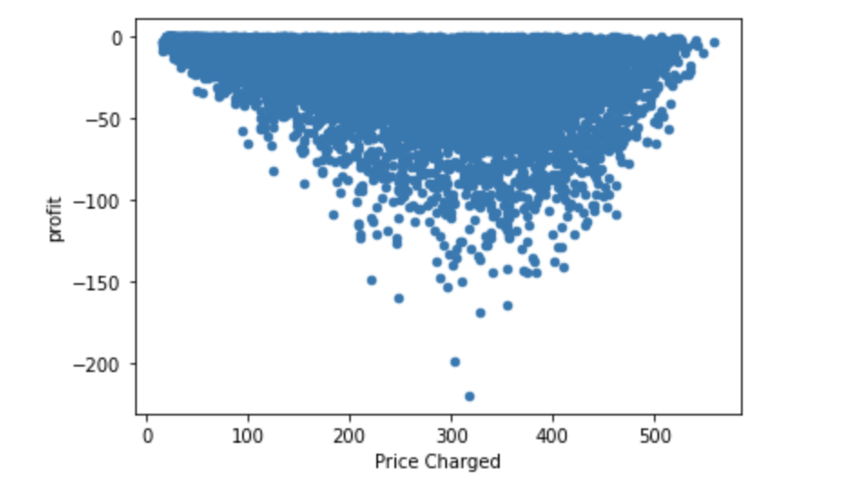
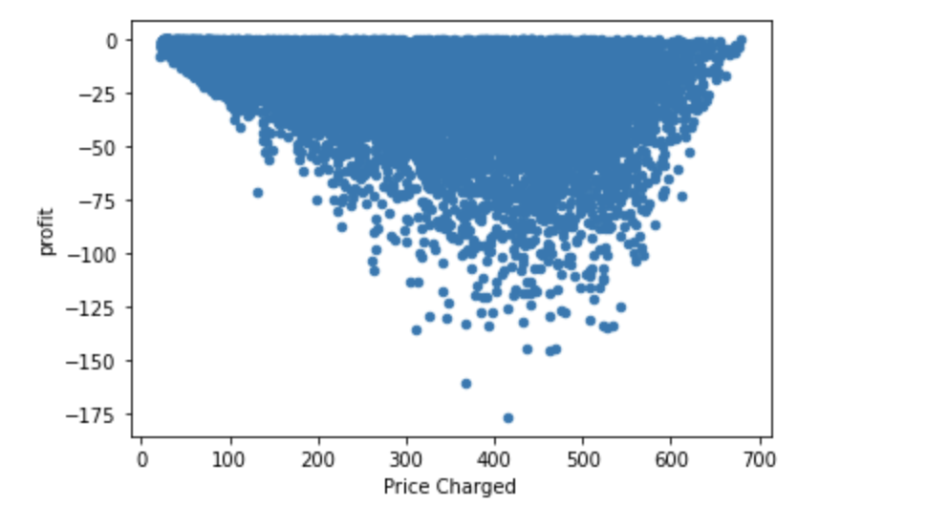
Situations lead to negative profits
Pink Cab
In most cases, the negative profit occurs when the price is 100 to 600, and the most significant negative profit occurs when the price is 300 to 400.
Comparing the two companies with each other, we can see that Yellow cab generates more negative profit
Yellow Cab

Slide 14
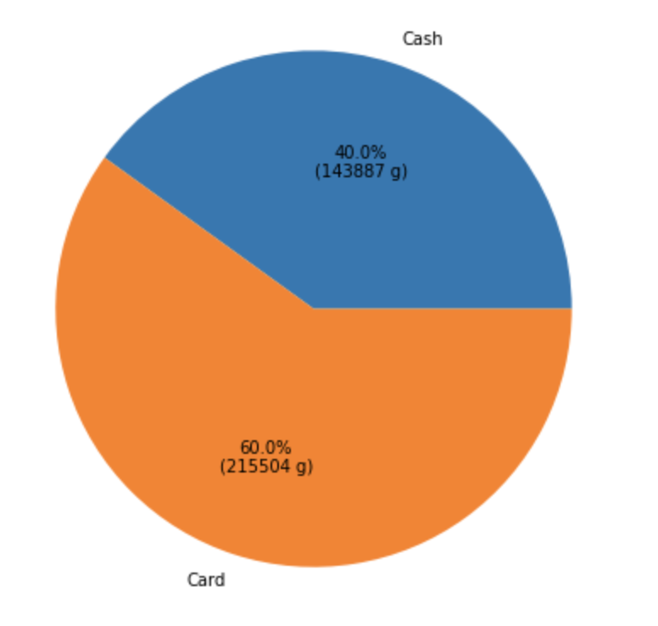
Payment method
Cash vs. Card

Slide 15
Payment method
We can see that most users prefer to pay by credit card
About 60% of users pay with credit card and 40% with cash
Next, we will discuss the connection between negative profit and payment method

Slide 16
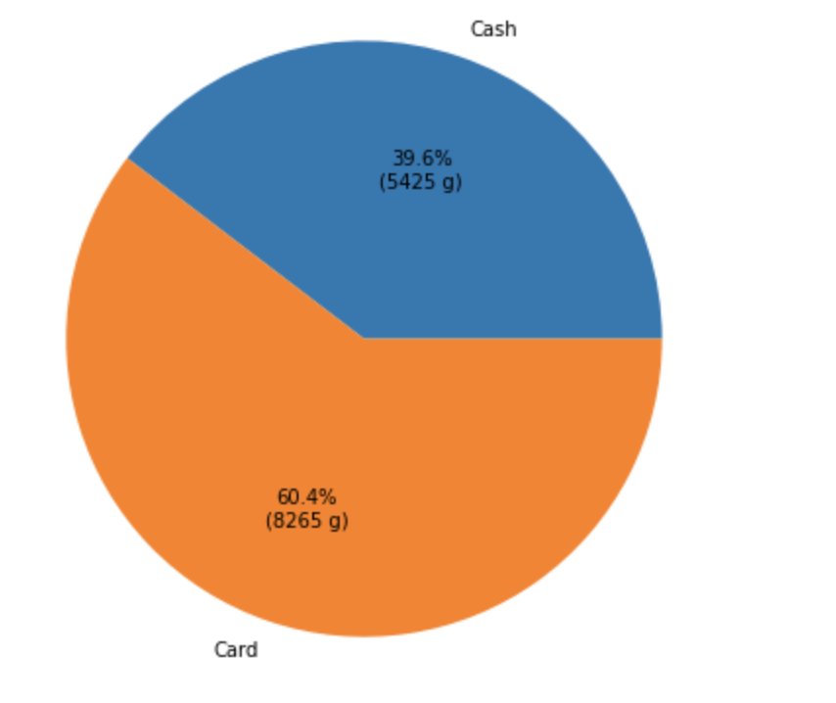
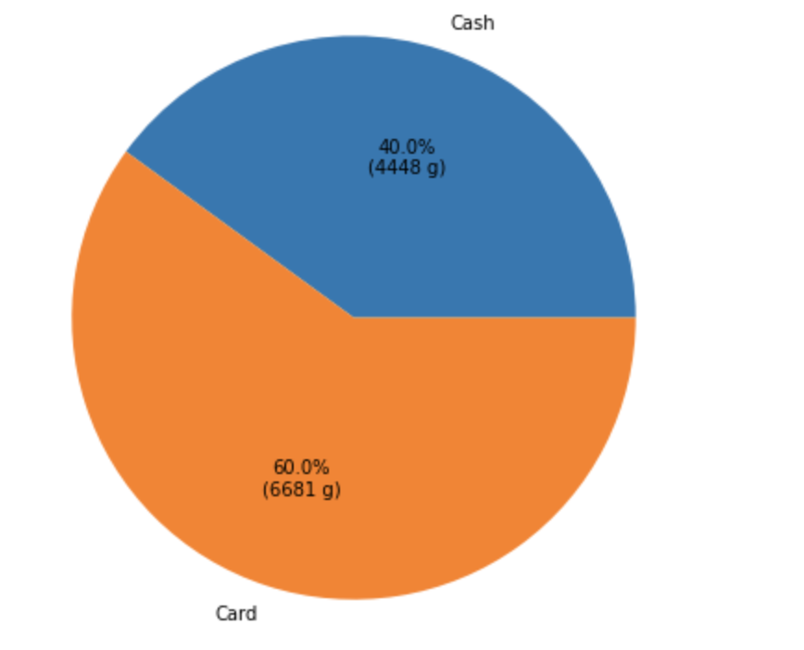
Connection between negative profit and payment method
Pink Cab
Yellow Cab

Slide 17
Connection between negative profit and payment method
The above data is the case of getting a negative profit. We divide this data into payment by credit card and payment by cash
We can see that 60% of the negative profit comes from credit card payments
We can conclude that using cash payments has a relatively small chance of resulting in negative profits

Slide 18
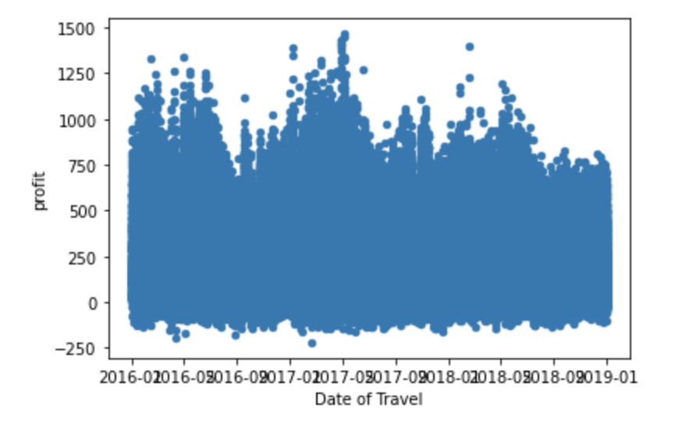
The relationship between profit and date

Slide 19
The relationship between profit and date
We can see that at the end of each year, the company's profit will be the lowest of the year
The most profitable time of year occurs in May
The above is the result of all the data; if we look at the data of the two companies separately, we will get different results (Next Slide)

Slide 20
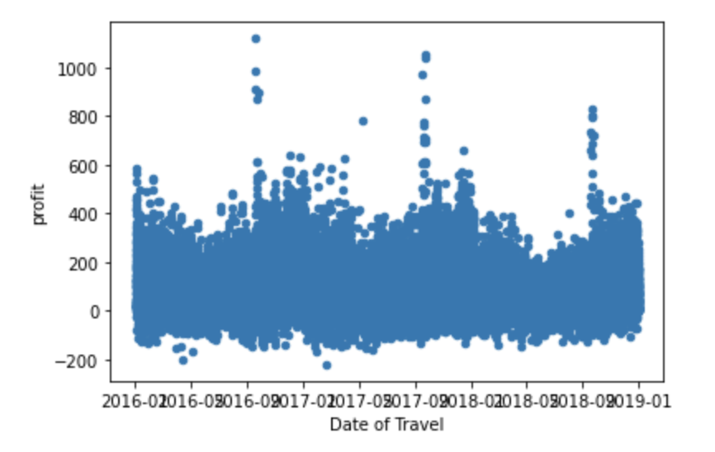
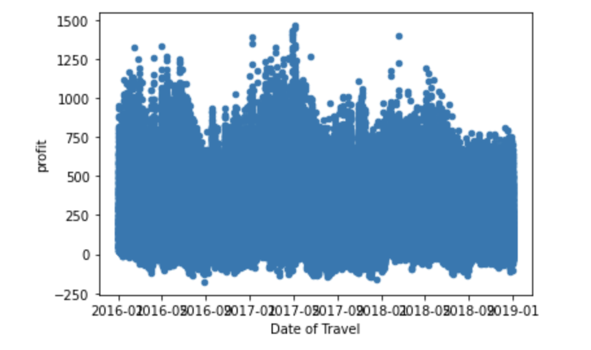
The relationship between profit and date (Pink Cab vs. Yellow Cab)
Pink Cab
Yellow Cab

Slide 21
The relationship between profit and date (Pink Cab vs. Yellow Cab)
From the above two graphs, we can once again see the difference in profit between the two companies. Yellow Cab has more profit than Pink Cab
Pink Cab often sees higher-than-normal profits at the end of the year
Most of Pink Cab's profits in a year are between 10 to 350, and Yellow Cab's profit is usually between 10 to 750
From the above points, we can conclude that in most cases, Yellow Cab has more profits and users than Pink Cab; therefore, we can conclude that Yellow Cab would be a better company for investment

Slide 22
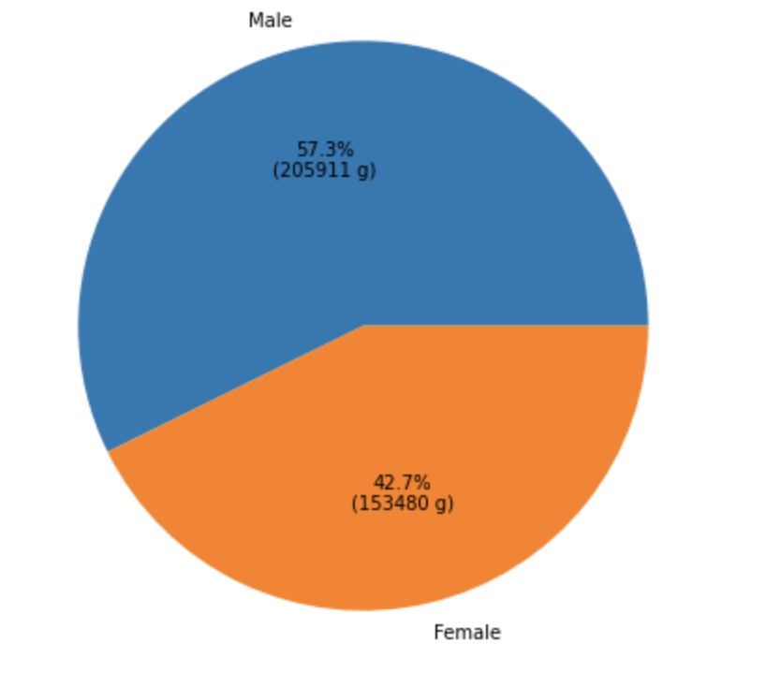
Gender ratio
We can see that there are more male users than female users

Slide 23
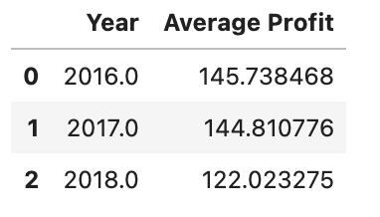
Average profit for the whole year
Our data is from 2016 to 2018. By calculating the average profit each year, we can see the trend of industry profits
From the above results, we can see that the average profit decreases year by year.

Slide 24
Hypothesis

Slide 25
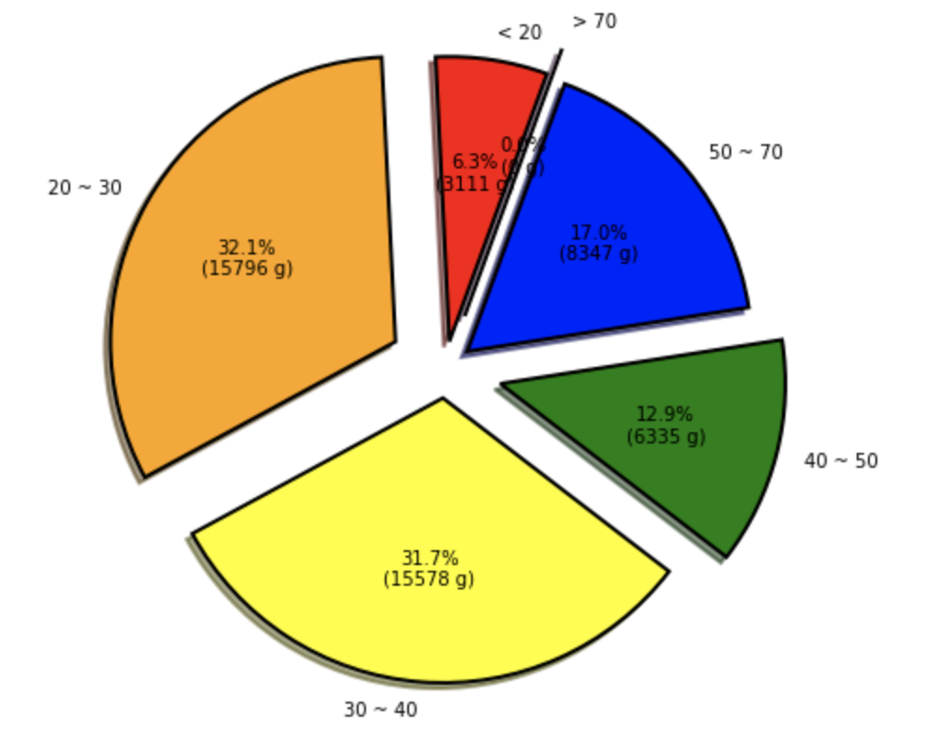
Hypothesis
Hypothesis 1:
Seniors may need more cab service
Result:
Adults (20-40) may need more cab service

Slide 26
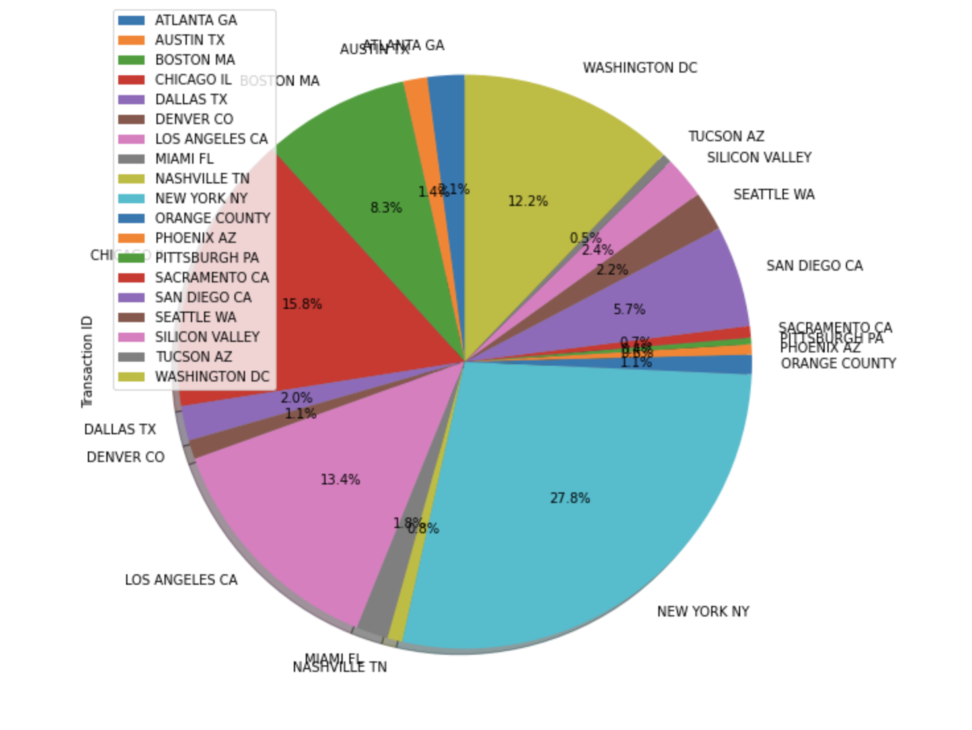
Hypothesis
Hypothesis 2:
Populous cities will have a more extensive customer base
Result:
We can see that most of the user base occurs in cities with high population density

Slide 27
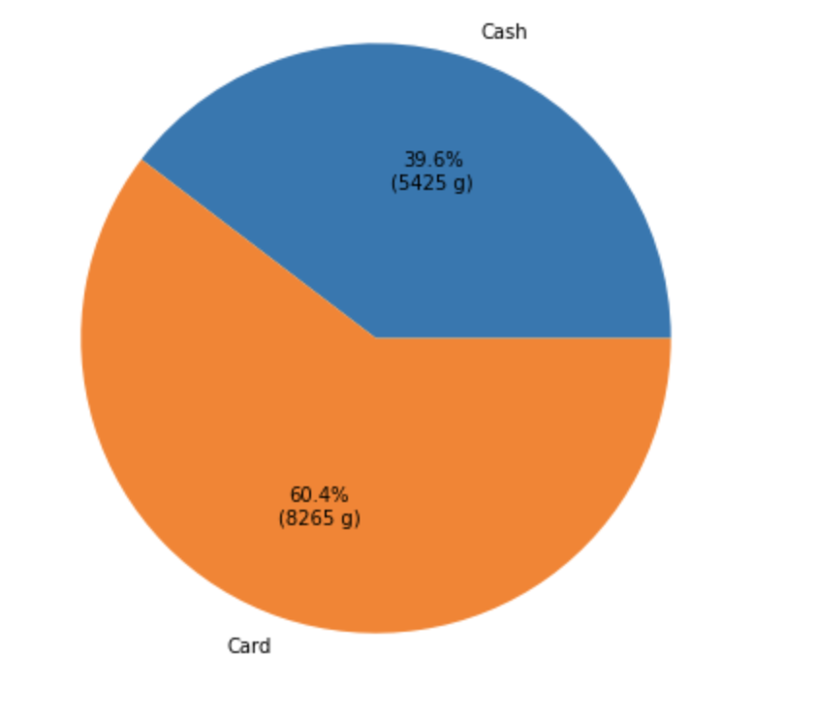
Hypothesis
Hypothesis 3:
Let customers pay in cash have a greater chance of making a profit
Result:
The results show that Credit card payments have more negative profits than cash payments, which means that letting users pay in cash will be a better choice
This graph shows the percentage of two paying methods in negative profits (Yellow Cab)

Slide 28
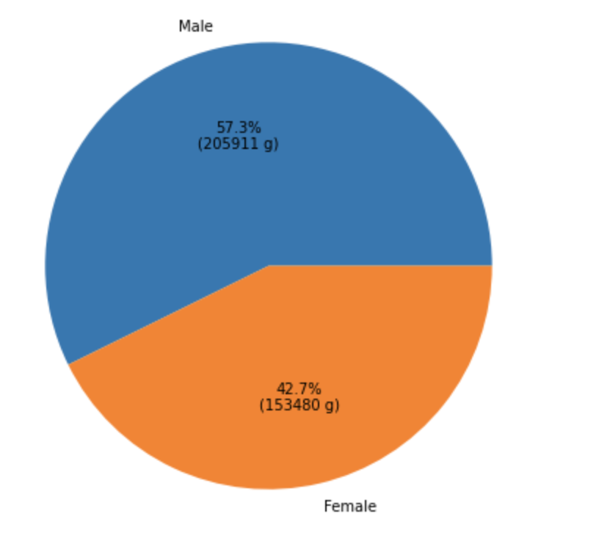
Hypothesis
Hypothesis 4:
Female are more likely to use this service than Male
Result:
More than half of the users are Male

Slide 29
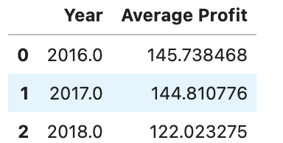
Hypothesis
Hypothesis 5:
Is the average profit increasing year by year?
Result:
From 2016 to 2018, we can see that average profits are decreasing year by year

Slide 30

Summary and Conclusion
Yellow Cab company is better than Pink Cab company
More users and more transactions
Greater profit (higher average profit)
Combining the above two points, we can see that Yellow Cab company has more industry strength

Slide 31

Final recommendation
Invest Yellow Cab company would be the best choice

Slide 32
Thank you

